Slide 1




Storytelling with data
An academic perspective
Dr. Liam D. Bailey
@ldbailey255
LiamDBailey/IZWPhDSymposium23

Slide 2

Storytelling with data
5 tips to improve your dataviz
An academic perspective
Dr. Liam D. Bailey
@ldbailey255
LiamDBailey/IZWPhDSymposium23

Slide 3
What we will cover?
- Introduce the idea of ‘Storytelling with data’
- 5 easy tips to enhance a data visualization
- Suggested R packages and further reading to learn more
Notes:
Explain what ggplot2 is!

Slide 4
What we won’t cover
- A dedicated {ggplot2} tutorial
- Creating all types of plots

Slide 5
Part I
What is Storytelling with Data?!

Slide 6




Data visualization in industry is different to academia!
Use paid products
Diverse audience (mostly non-experts)
Interested in decision making NOT details

Slide 7
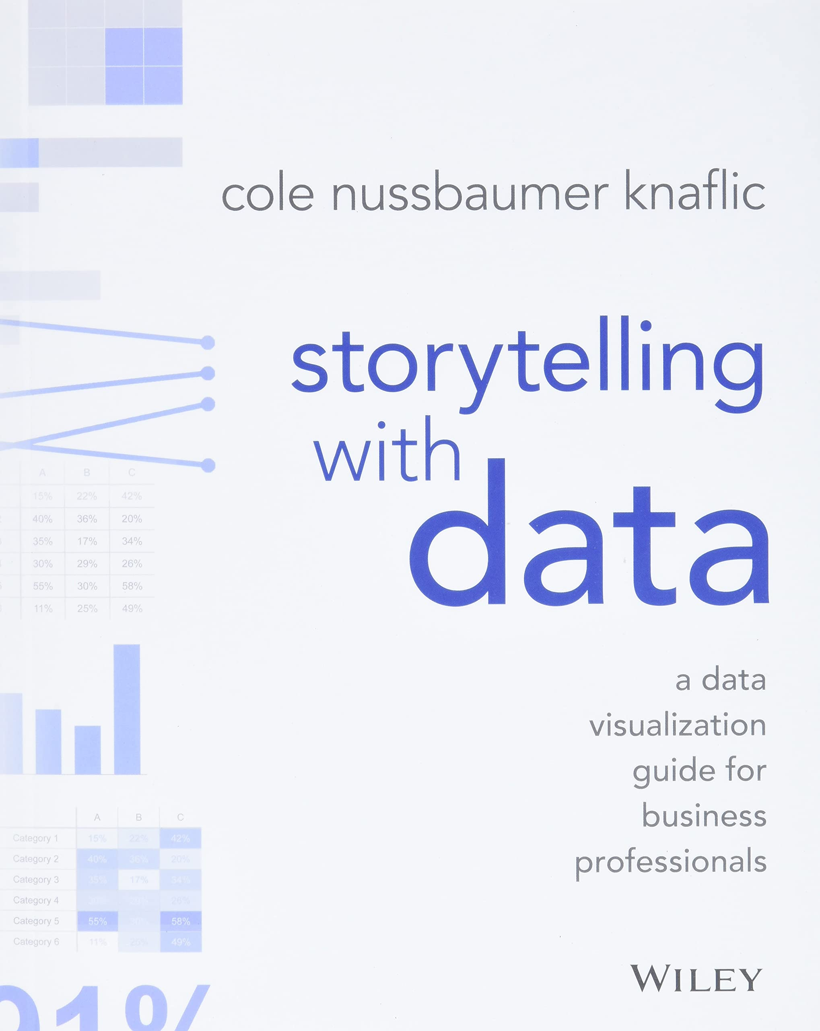
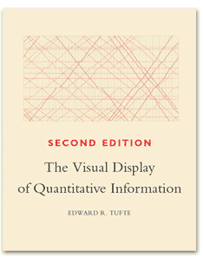
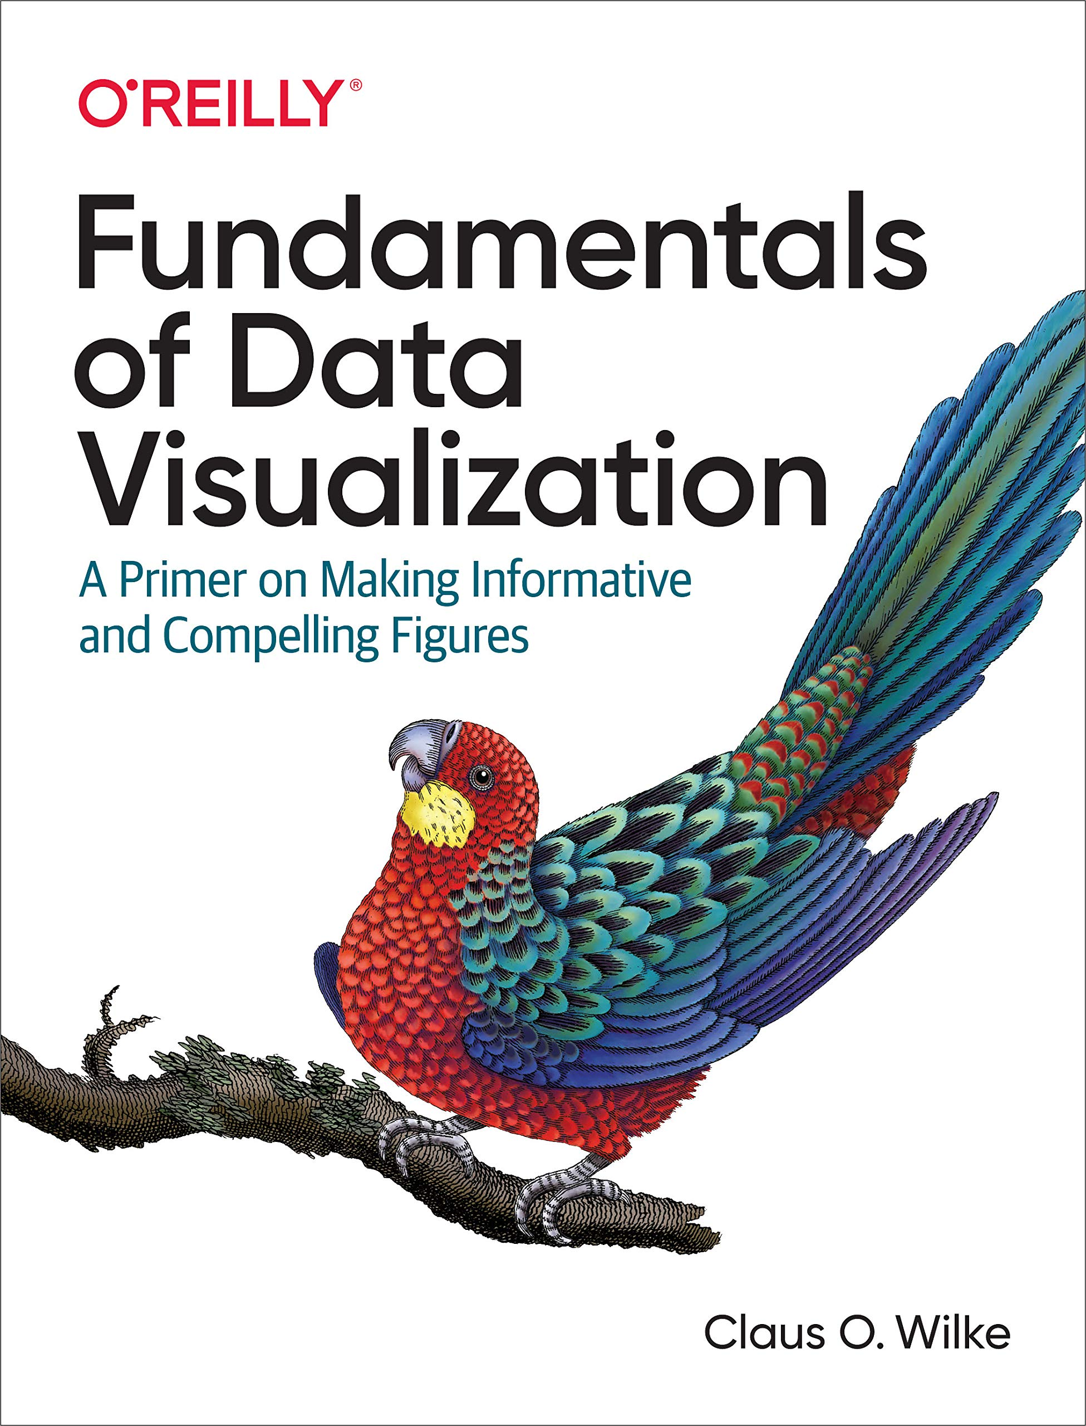

Academia can learn from industry and data viz professionals

Slide 8
1
2
3
4
5
6
Understand the context
Choose the right visual
Eliminate clutter
Focus attention
Make it accessible
Tell a story

Slide 9
Part II
5 tips to improve your visuals

Slide 10
1
2
3
Use pre-attentive traits
Understand context
Eliminate clutter
4
5
Communicate with text
Filter data

Slide 11
1
Understand context

Slide 12
How will you present?

Slide 13
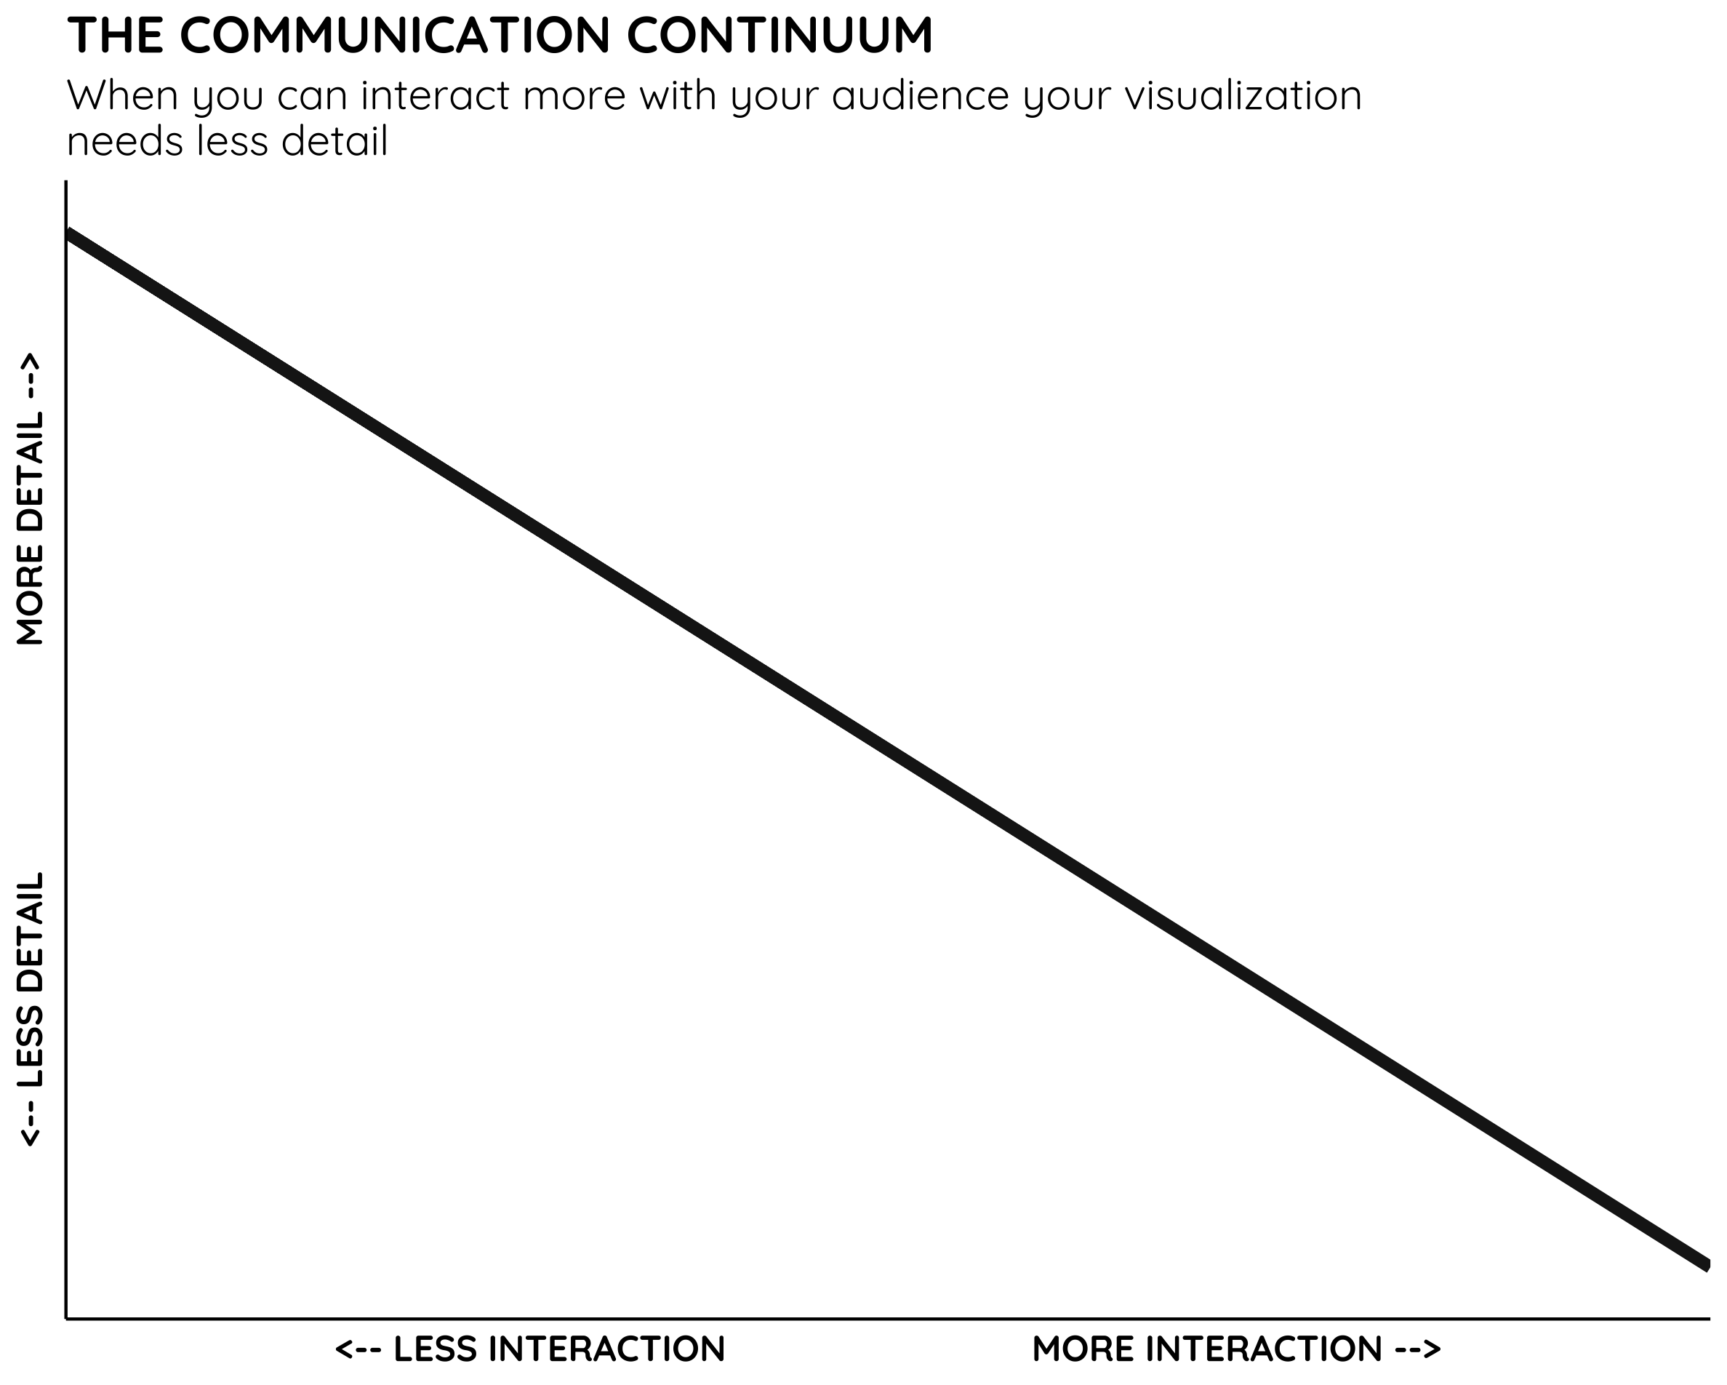
Poster
Short talk
Workshop
Journal article

Slide 14
Who is your audience?

Slide 15
How much knowledge does the audience have?
Limited knowledge (e.g. general public)
Expert knowledge (e.g. specialty conference)

Slide 16
What is your goal?

Slide 17


Read your paper
Change behaviour

Slide 18
There is no ONE good way to visualize your data!

Slide 19
2
Eliminate clutter

Slide 20

Data-to-ink ratio
Signal-to-noise ratio
Clutter

Slide 21
“
…anything that isn’t adding informative value
”

Slide 22
“
…anything that isn’t adding (enough) informative value
”

Slide 23
Global Fishing data from Our World in Data
How will you present?
15 min talk with slides (high control, low detail)
Who is your audience?
General public (not necessarily fisheries experts)
Limited knowledge
Want to learn about the topic
What is your goal?
Show how China has become the global leader in fisheries

Slide 24
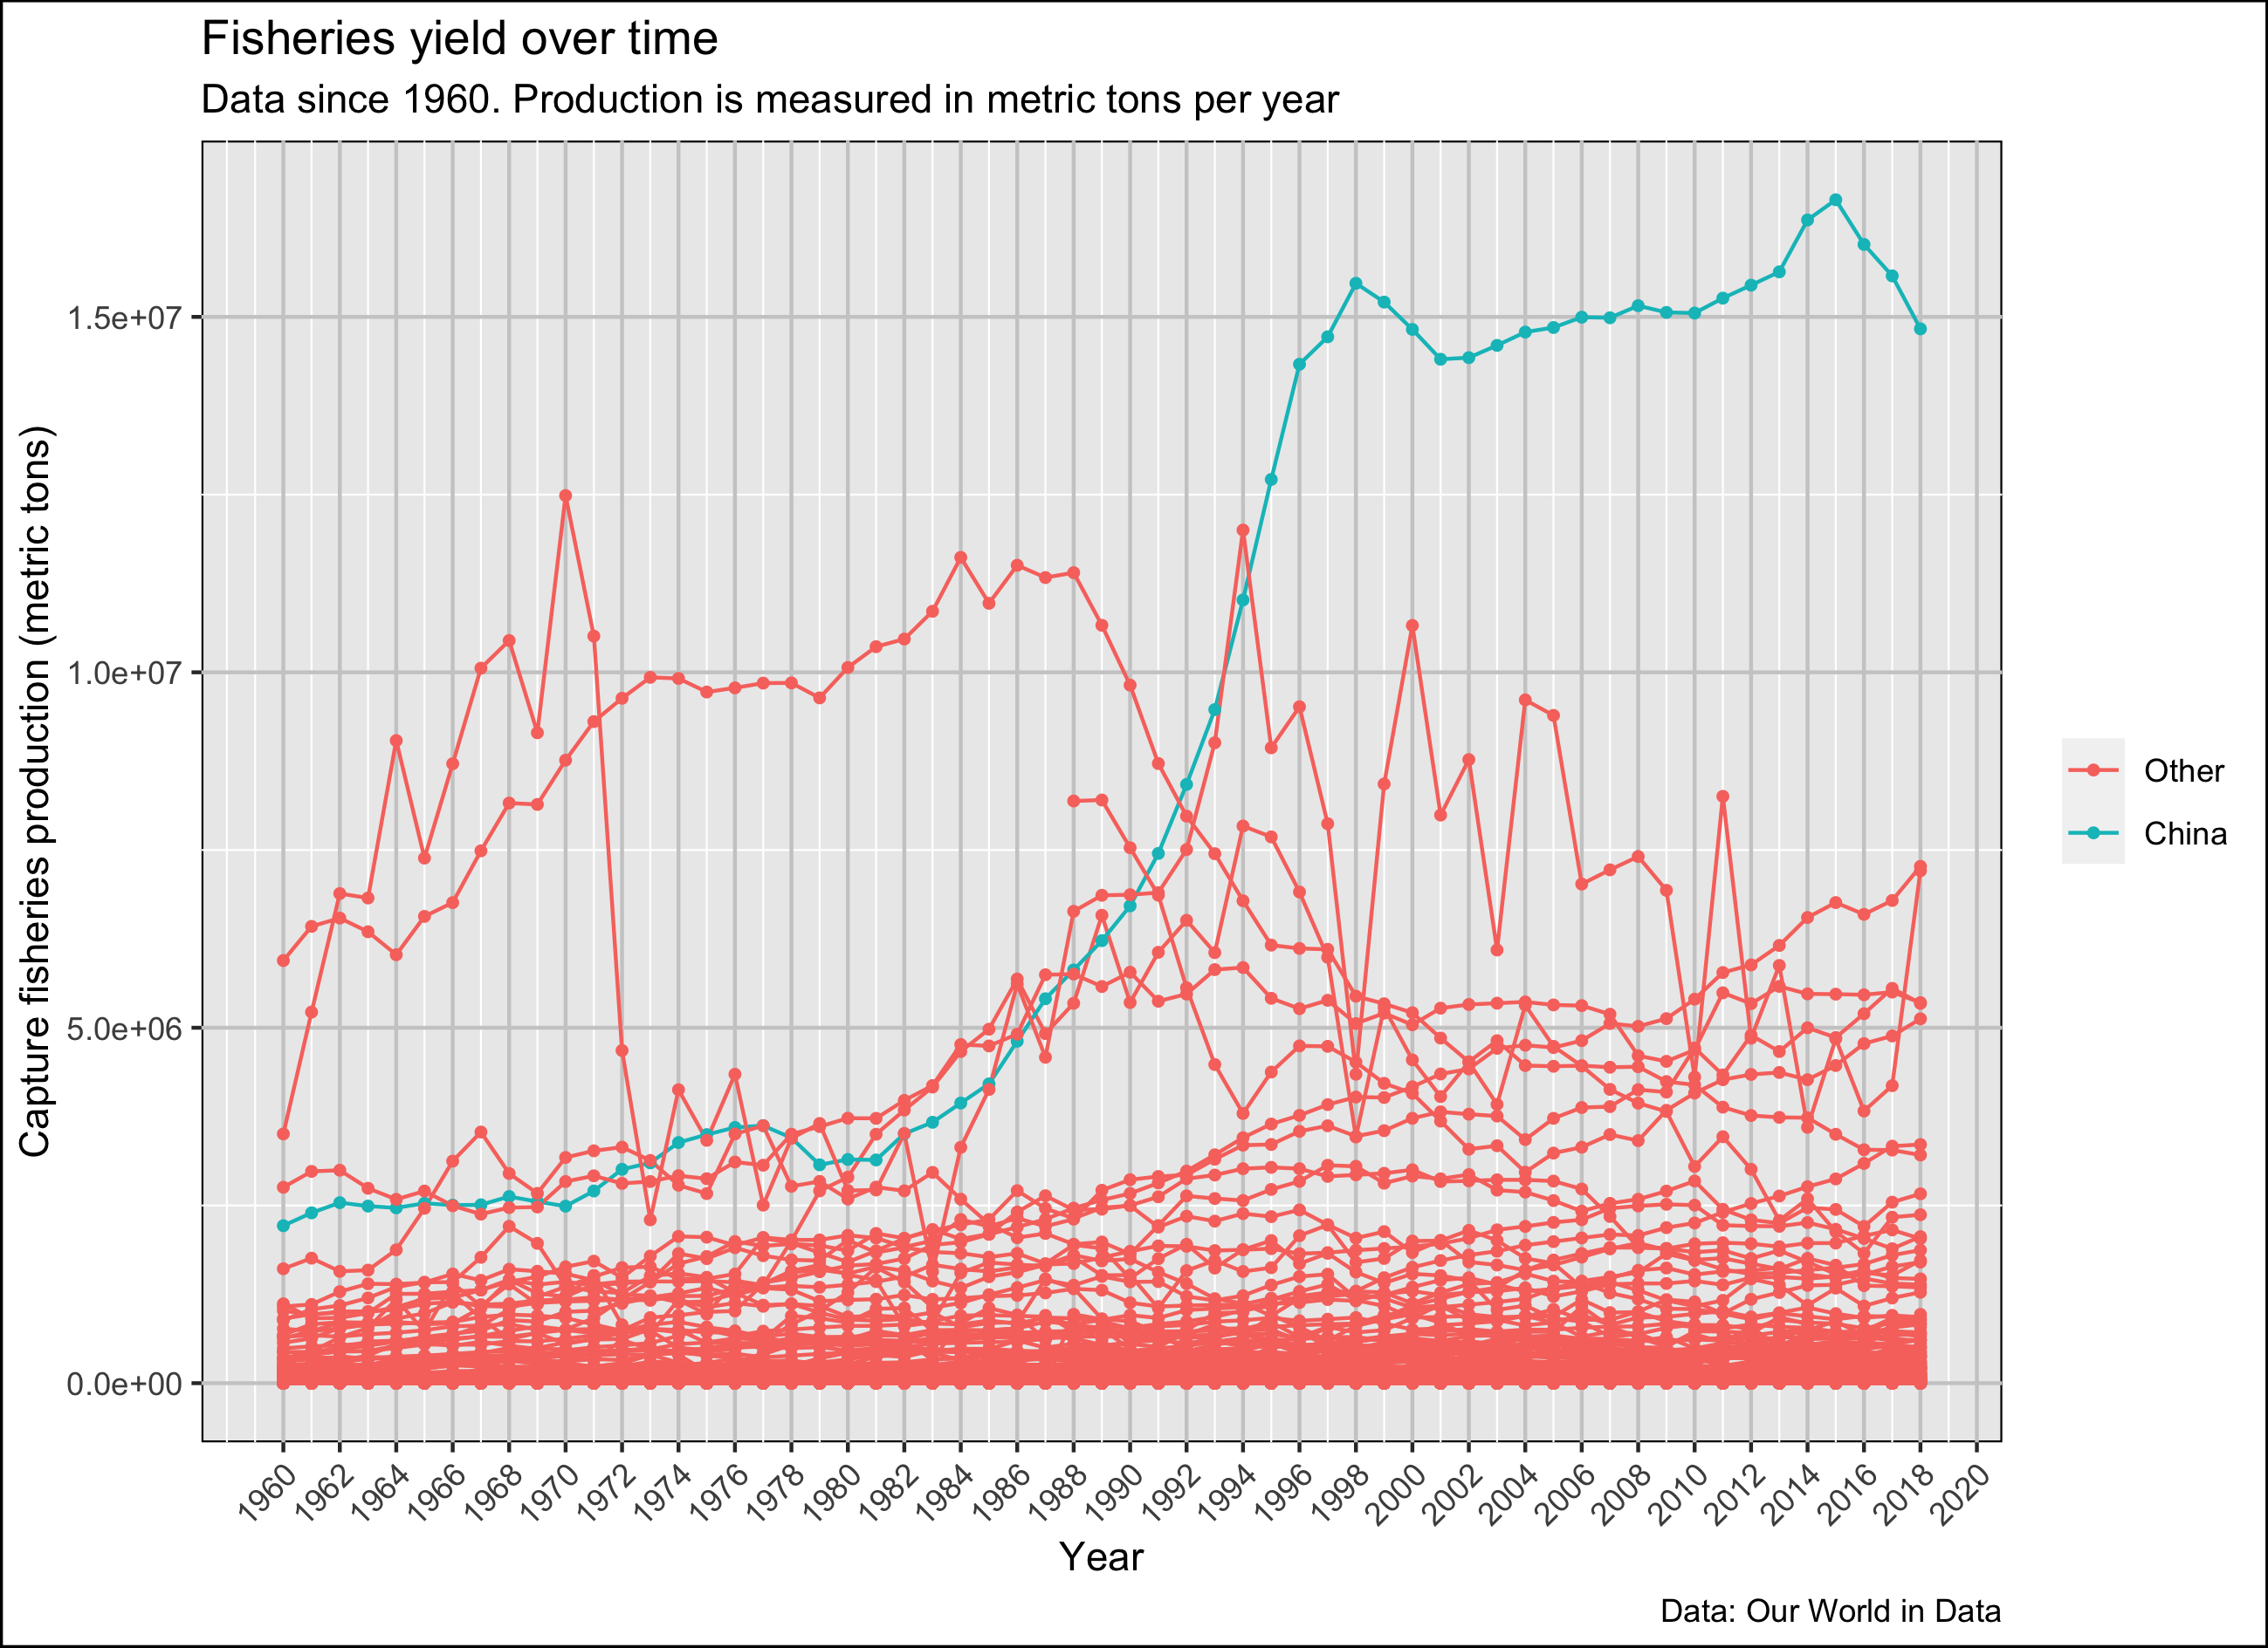
Notes:
They should say what they think is ‘clutter’ and WHY it is clutter.

Slide 25
Bounding boxes are unnecessary

Slide 26
Grid lines and background are distracting

Slide 27
Redundant
Redundant
Redundant

Slide 28
Scientific notation is hard to read
Too many ticks
Wigdor et al. 2005

Slide 29
Legends can be hard to read

Slide 31
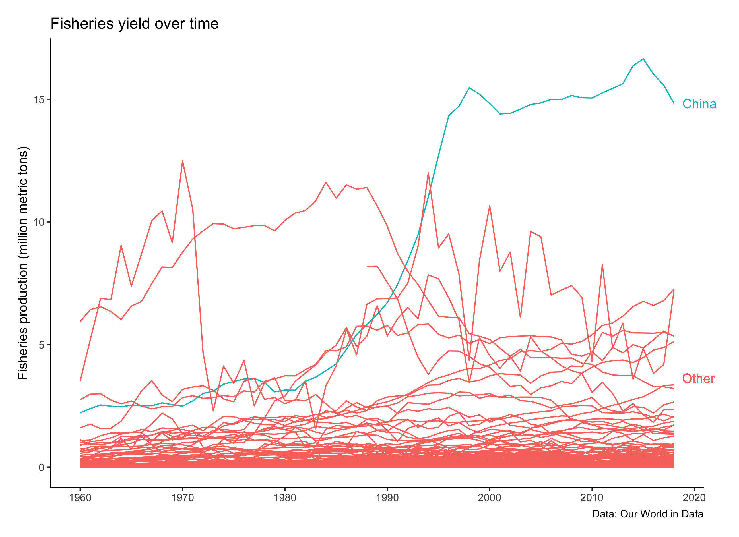

Slide 32
3
Use pre-attentive traits

Slide 33
“
Use pre-attentive traits to draw the viewer’s attention to the important points
”

Slide 34
“
Use pre-attentive traits to draw the viewer’s attention to the important points
”

Slide 35
“
Use pre-attentive traits to draw the viewer’s attention to the important points
”

Slide 36
“
Use pre-attentive traits to draw the viewer’s attention to the important points
”

Slide 37
“
Use pre-Attentive trAits to drAw the viewer’s Attention to the importAnt points
”

Slide 38
“
Use pre-attentive traits to draw the viewer’s attention to the important points
”

Slide 40
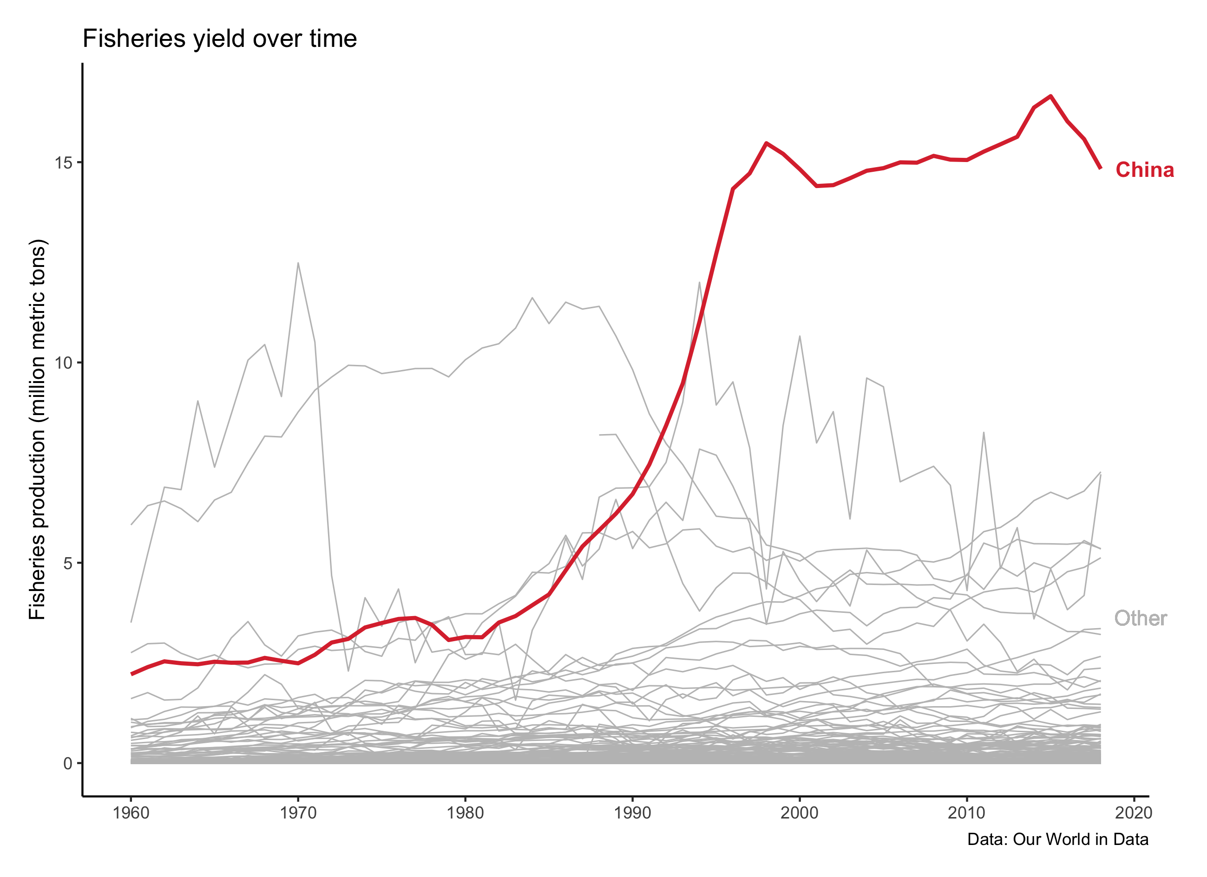

Slide 41
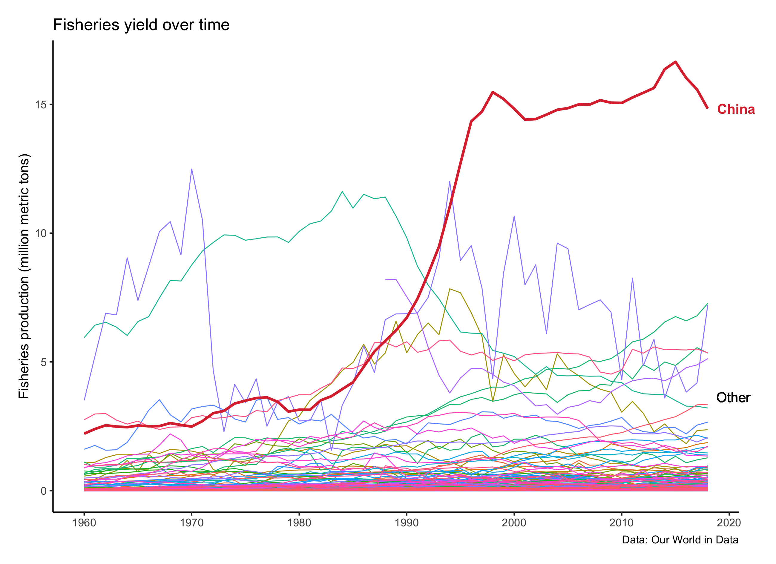

Slide 42
4
Communicate with text

Slide 43
“
If there is a conclusion you want your audience to reach, state it in words
”

Slide 45
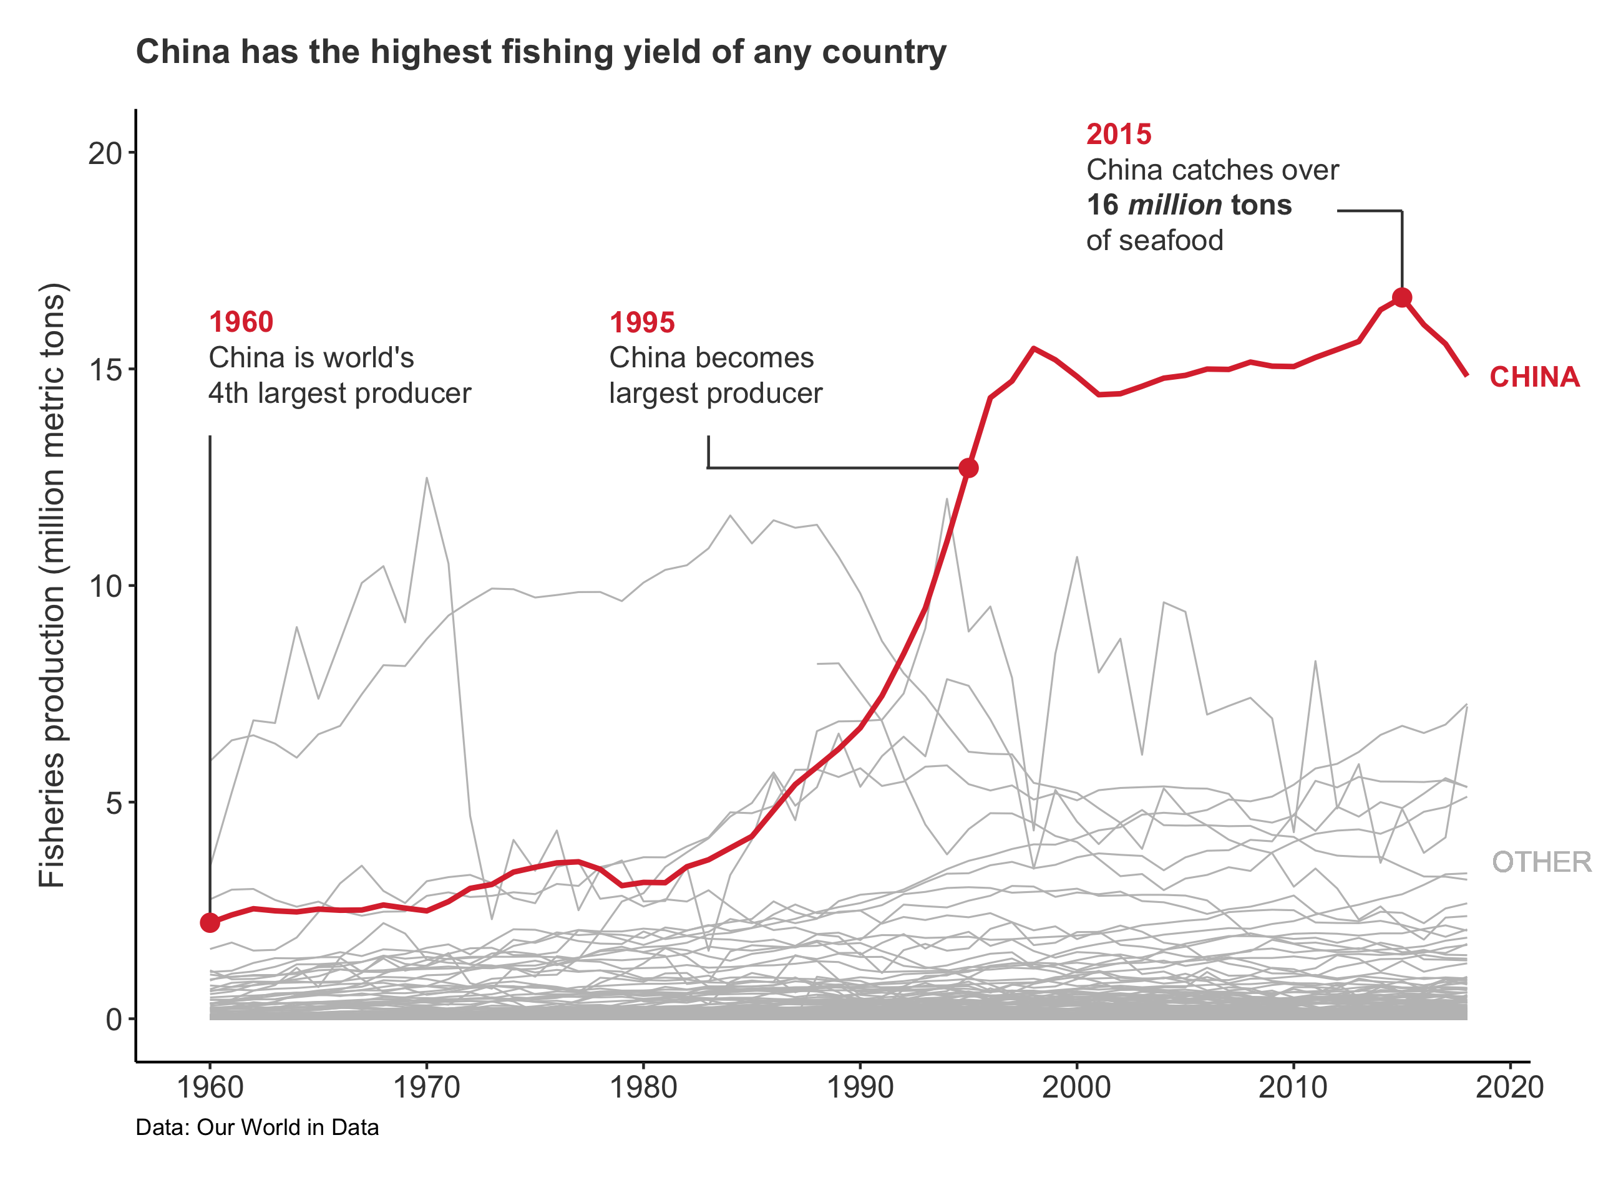

Slide 46
5
Filter data

Slide 47
“
Not all data are equally important
”

Slide 49
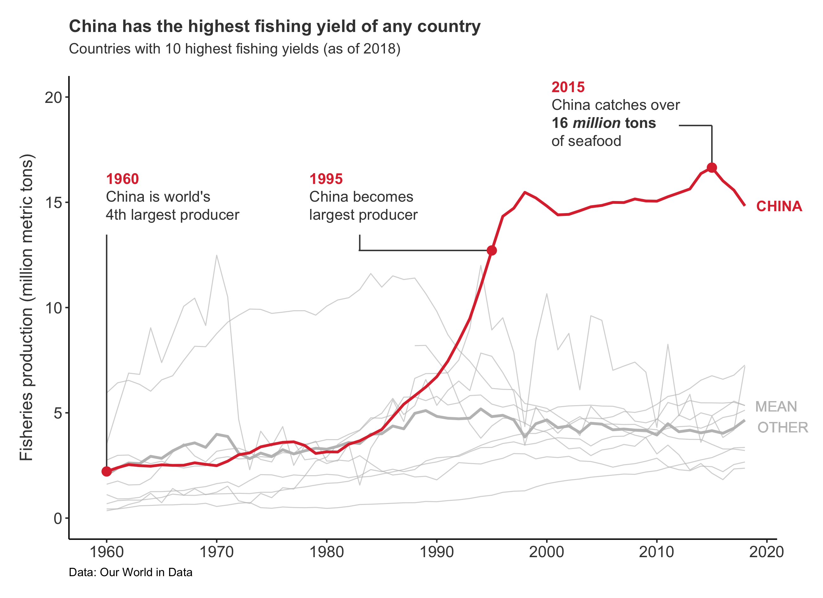

Slide 50
1
2
3
Use pre-attentive traits
Understand context
Eliminate clutter
4
5
Communicate with text
Filter data

Slide 53
Part III
Dataviz tips in the wild

Slide 54
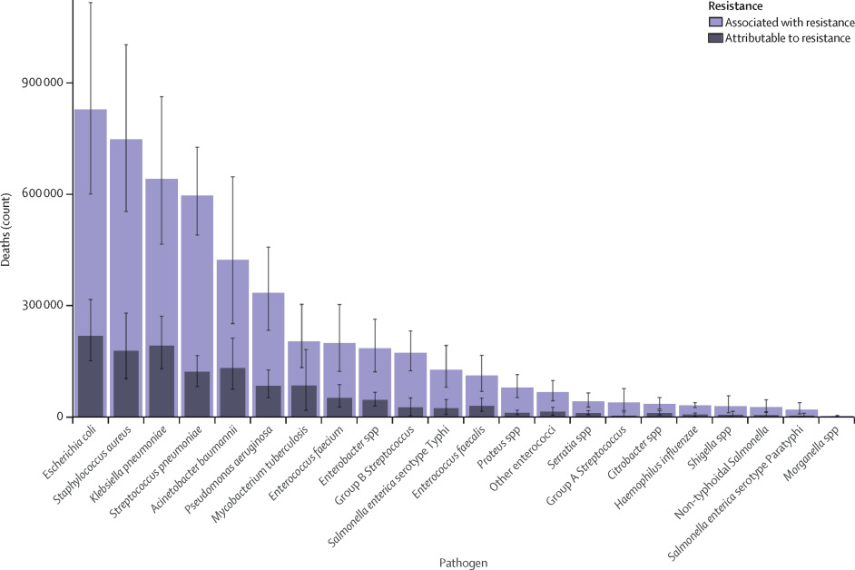
Murray et al. (2022) Lancet
Notes:
What is the legend for this plot?!

Slide 55
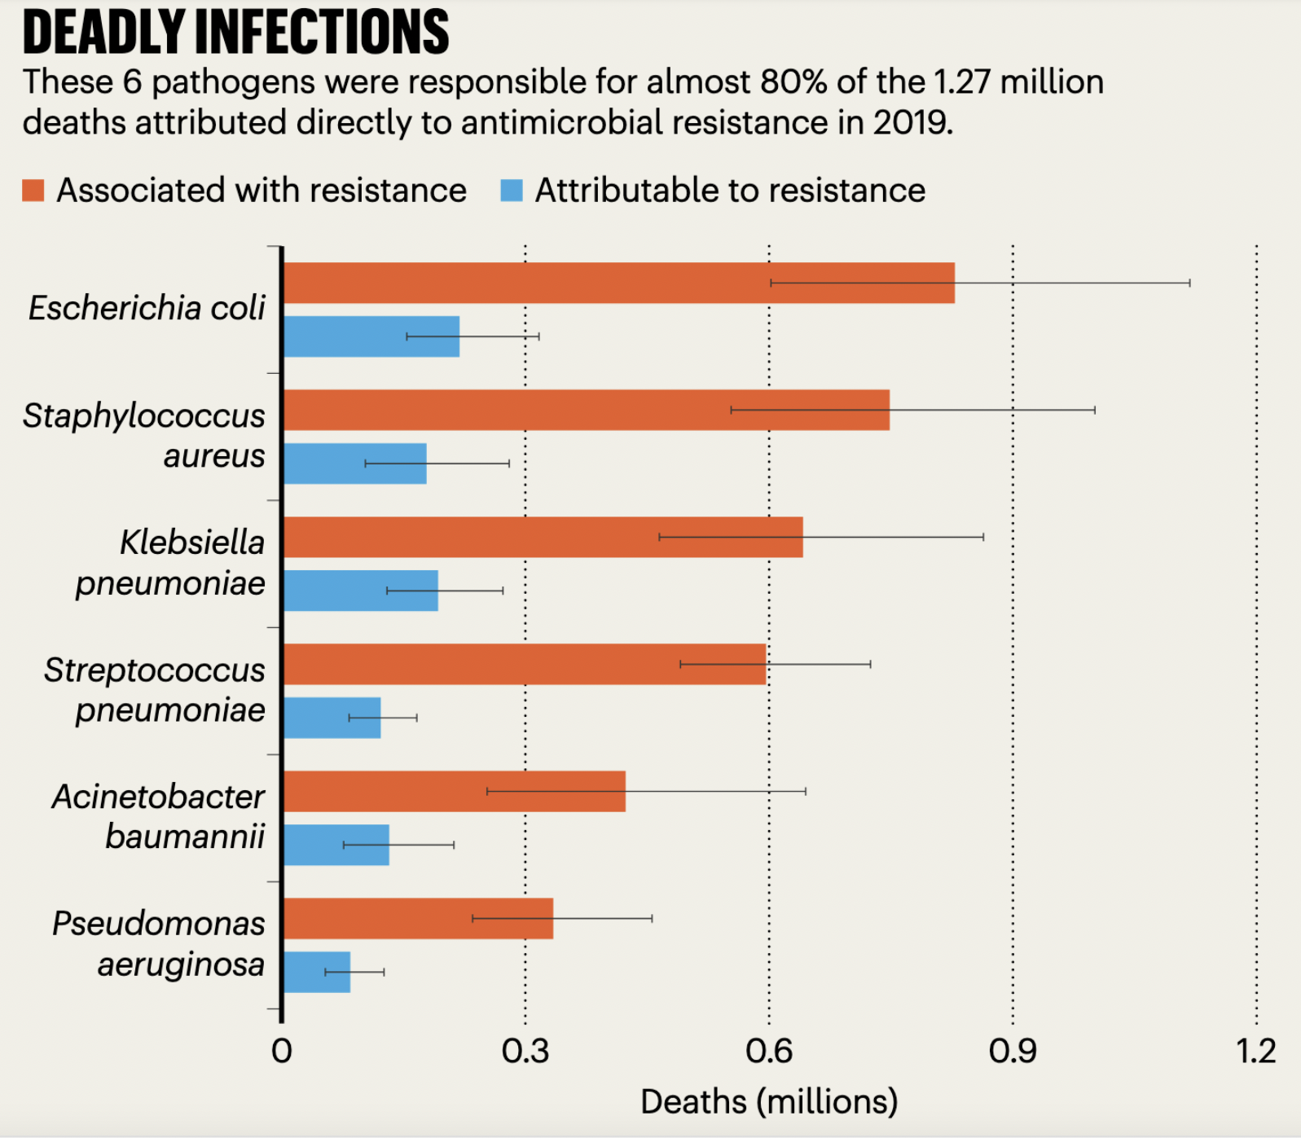
Thompson (2022) Nature

Slide 56
5
Filter data
4
Communicate with text
3
Use pre-attentive traits
2
Eliminate clutter

Slide 57
Part IV
What do journals think?

Slide 58

“
Where possible, text, including keys to symbols, should be provided in the legend rather than on the figure itself
”
“
Nature Portfolio charges our authors a fee for the printing of their colour figures
”
Notes:
https://www.nature.com/nature/for-authors/formatting-guide
“The goal is for figures to be comprehensible to readers in other or related disciplines”
“Avoid unnecessary complexity, colouring and excessive detail”
“Where possible, text, including keys to symbols, should be provided in the legend rather than on the figure itself.”
“Nature Portfolio charges our authors a fee for the printing of their colour figures”

Slide 59

“
Avoid using grayscale
”
“
Avoid using color type
”
“
The cost of color illustrations is $650 for the first color figure and $450 for each additional color figure
”
Notes:
https://www.science.org/content/page/instructions-preparing-initial-manuscript#preparation-of-figures
“Avoid wide variation in type size within a single figure.”
“The figure’s title should be at the beginning of the figure legend, not in the figure itself.”
“Avoid using grayscale”
“Variables are always set in italics or as plain Greek letters”
“Avoid using color type”
“The cost of color illustrations is $650 for the first color figure and $450 for each additional color figure.”
“Avoid wasted white space and clutter.”

Slide 60

“
Images should be minimally processed and accurately reflect the original data
”
Notes:
https://royalsociety.org/journals/authors/author-guidelines/

Slide 61
Journals are not (always) the ones stopping us from making better figures

Slide 62
1
Understand context

Slide 63
Part V
Further resources

Slide 64
Apply these tips in R
{ggtext}
{dplyr}
{ggplot2}
{tidyr}
{gt}
{ggrepel}
Notes:
Add hex stickers. Have a table after that has the info what each is used for.

Slide 65



Apply these tips in R
&
Prepare your data before plotting
{dplyr} {tidyr}:
{ggtext}:
Add pre-attentive traits to your text
{ggrepel}:
Prevent overlapping text labels
Present your data in a table
{gt}:
Notes:
Add hex stickers. Have a table after that has the info what each is used for.

Slide 66


Slide 67
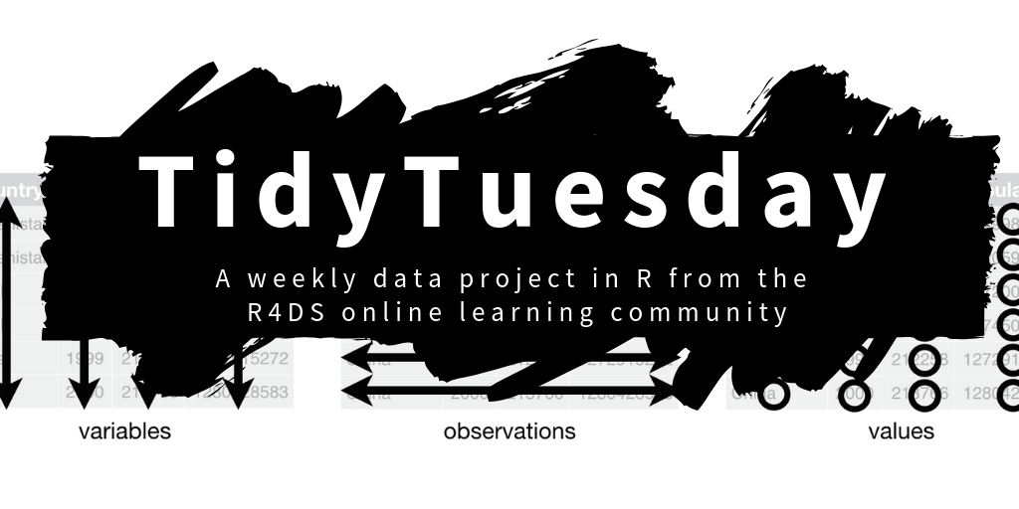

Slide 68
Storytelling with data
5 tips to improve your dataviz
An academic perspective
Dr. Liam D. Bailey
@ldbailey255
LiamDBailey/IZWPhDSymposium23

Slide 69
Part V
Bonus content

Slide 70
6
Arrange data

Slide 71
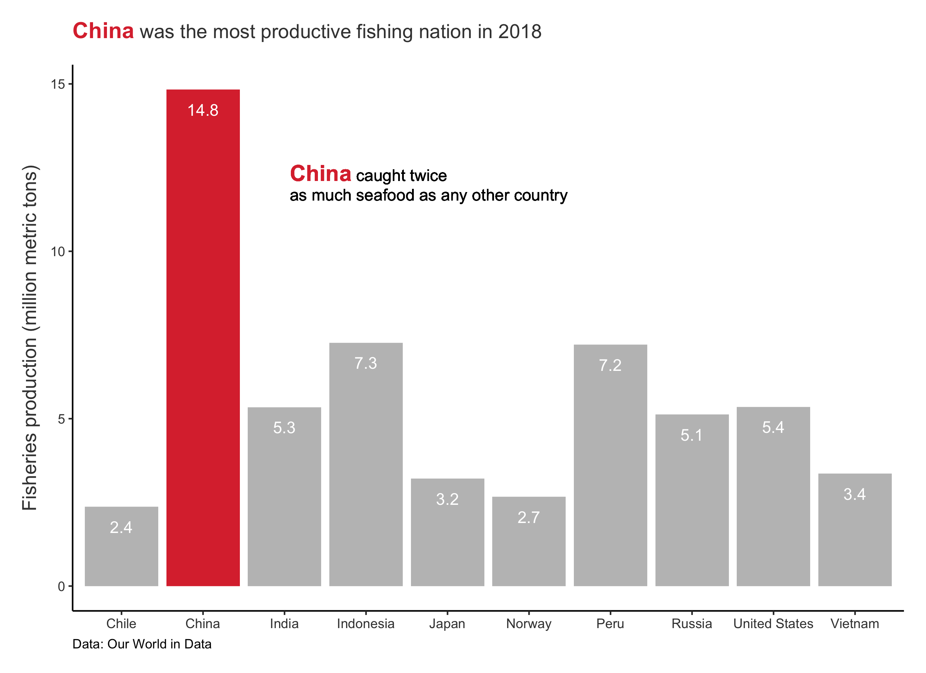

Slide 73
PRIME REAL-ESTATE

Slide 74
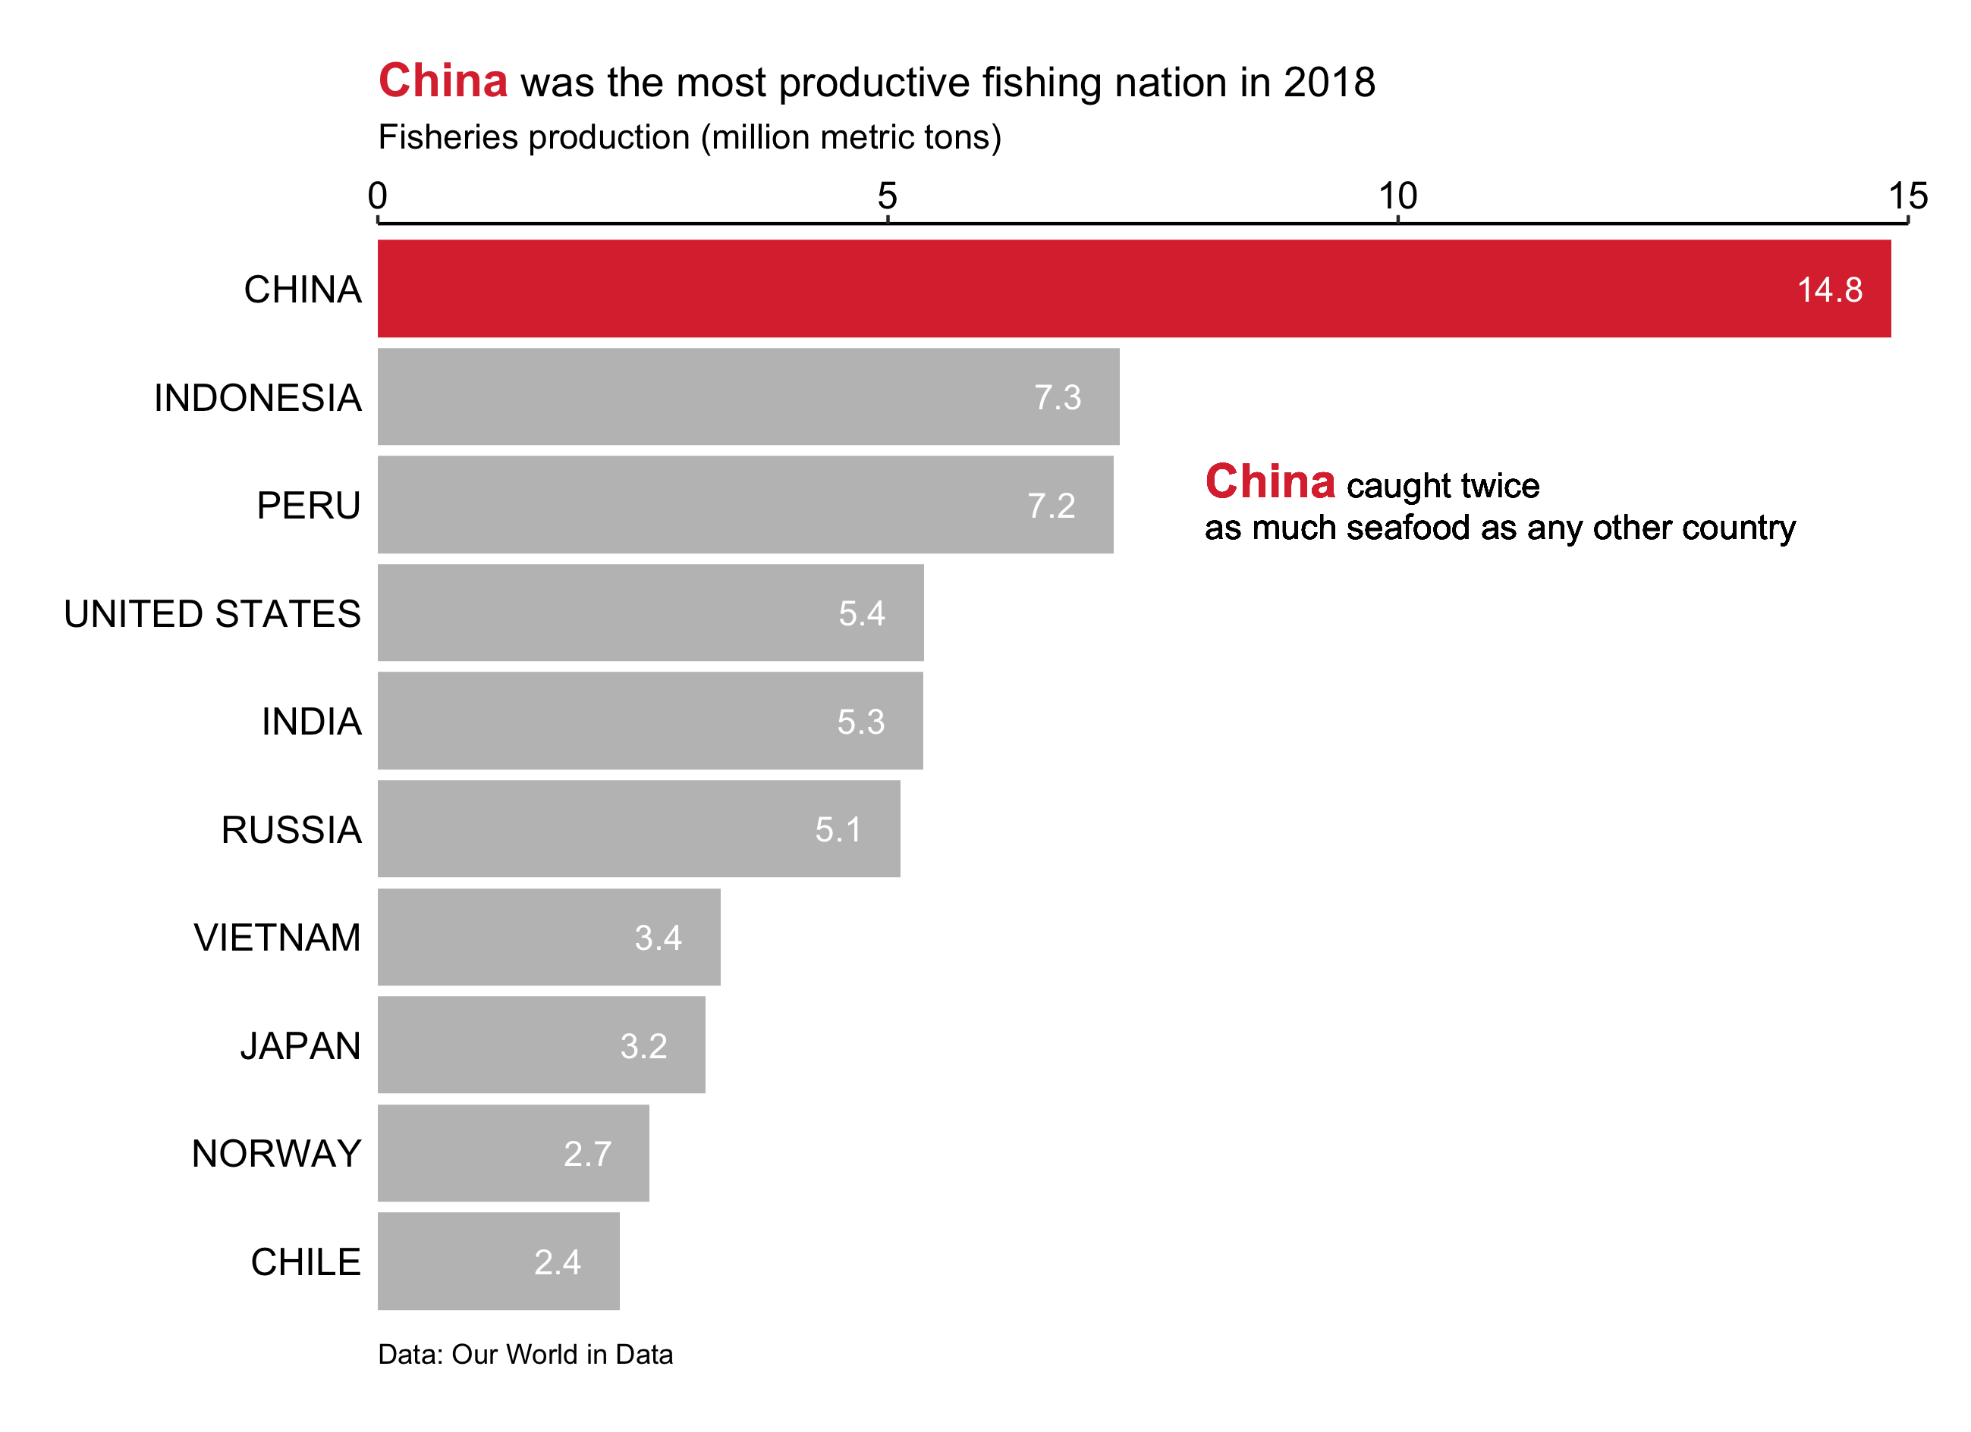

Slide 75
Thompson (2022) Nature

Slide 76
7
Accessibility

Slide 77
“
You might be an engineer, but it shouldn’t take someone with an engineering degree to understand your graph
”

Slide 79
